Slide 1


PLANT DISEASE CLASSIFICATION USING CNN
DEEP LEARNING PROJECT DOCUMENTATION

Slide 2

This project is a practical application of deep learning, where a Convolutional Neural Network (CNN) was built to classify plant leaf diseases using images.
The main work in this project focused on writing the code, training the model, and analyzing the results, while the dataset was prepared in advance.
ABOUT US

Slide 3



INTRODUCTION
Plant diseases have a significant impact on agricultural productivity and crop quality. Early and accurate detection of plant diseases is essential to reduce crop losses and improve food production.
With the advancement of deep learning and computer vision, Convolutional Neural Networks (CNNs) have become an effective approach for image-based classification tasks. In this project, a CNN model is developed to classify plant leaf diseases using image data.
The project demonstrates a complete deep learning workflow, including data preprocessing, model training, evaluation, and result analysis, highlighting the practical application of CNNs in real-world agricultural problems.

Slide 4
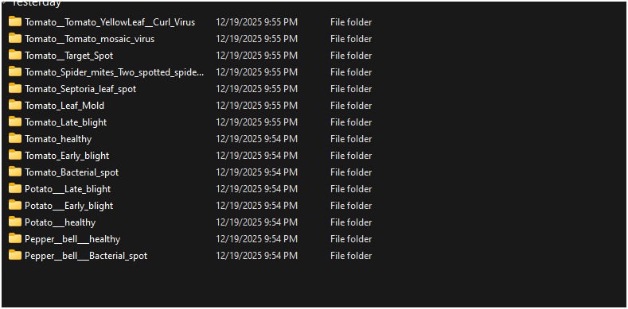
Add a subThe dataset used in this project was collected from Kaggle and contains images of plant leaves affected by different diseases, as well as healthy leaves.
The dataset includes images from multiple plant types such as tomato, potato, and pepper.
Each disease category is stored in a separate folder, where each folder represents a single class.
This structure allows easy loading of the dataset using TensorFlow tools and enables automatic label assignment based on folder names.
The dataset provides a sufficient number of images for training, validation, and testing, making it suitable for building and evaluating a CNN-based image classification model.
heading
DATASET DISCRPTION

Slide 5

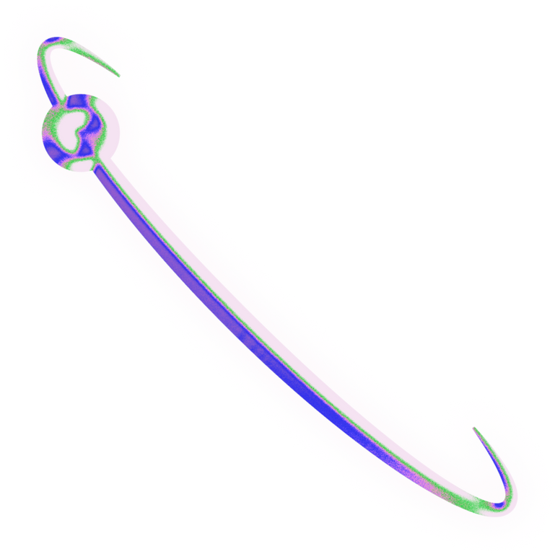
Growth in Deep Learning Applications
CNN in Agriculture
Image-Based Diagnosis
CURRENT TRENDS
CNN models are widely used for image classification tasks, especially in agriculture.
Deep learning enables automatic and accurate plant disease detection
Computer vision techniques are increasingly used for analyzing plant leaf images

Slide 6
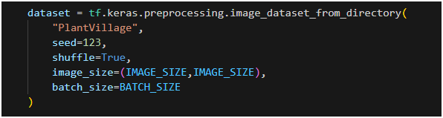
The dataset is loaded using TensorFlow’s image_dataset_from_directory function.
This function reads images from a directory structure where each folder represents a class label.
Images are automatically resized to a fixed size using the image_size parameter during dataset loading and grouped into batches to optimize memory usage during training.
Shuffling is applied with a fixed seed to ensure a random but reproducible distribution of images, which helps improve model generalization.
DATA LODING

Slide 7

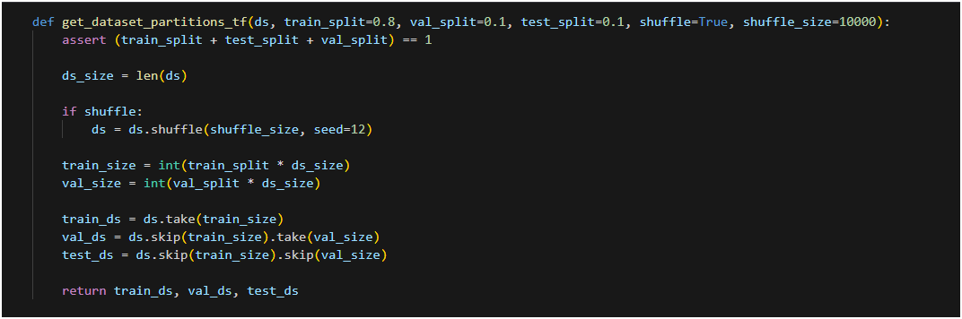
DATASET SPLITTING
The dataset is divided into three subsets: training, validation, and testing. This split is implemented using a custom function that partitions the dataset after shuffling to ensure a balanced and unbiased distribution. The training set is used to train the CNN model, the validation set is used to monitor performance during training, and the test set is used for final evaluation on unseen data. Using separate subsets helps assess the model’s generalization ability and prevents data leakage.

Slide 8
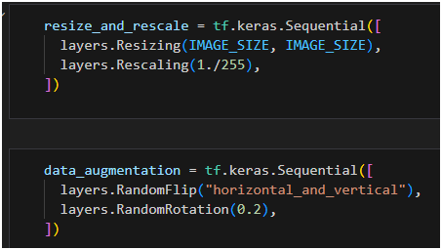

PREPROCESSING & DATA AUGMENTATION
Before training the model, the image data is preprocessed to ensure consistency and improve learning performance.
All images are rescaled by normalizing pixel values from the range 0–255 to 0–1, which helps stabilize and speed up the training process.
In addition, data augmentation techniques are applied during training to increase data variability.
These techniques include random flipping and random rotation of images, which help reduce overfitting and improve the model’s ability to generalize to unseen data.

Slide 9
MODEL ARCHITECTURE
CNN Architecture
Convolutional Layers
Classification Layer
The model is built using a Convolutional Neural Network (CNN) implemented with Keras Sequential API to process RGB images and extract features automatically.
Multiple Conv2D layers with increasing filters are used, followed by MaxPooling2D layers to reduce spatial dimensions and computational complexity. ReLU activation is applied to improve learning efficiency.
Global Average Pooling is applied to reduce overfitting, followed by a Dense layer with Softmax activation to output class probabilities.

Slide 10
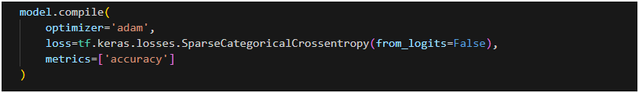

MODEL COMPILATION
The CNN model is compiled using the Adam optimizer, which is widely used for its efficiency and adaptive learning rate.
The Sparse Categorical Crossentropy loss function is selected because the class labels are represented as integer values.
Model performance is evaluated using accuracy as the main metric.
The from_logits parameter is set to False since the output layer uses the Softmax activation function.

Slide 11
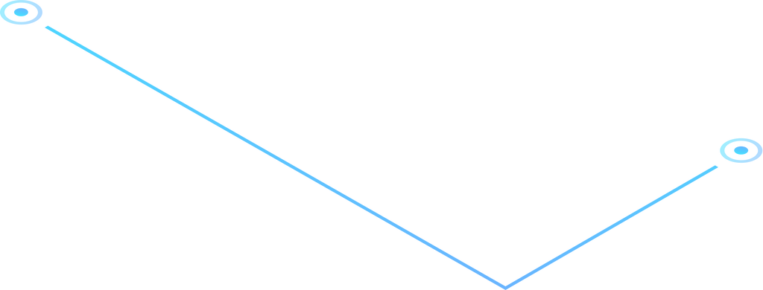
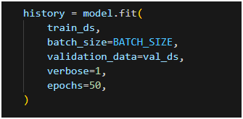
The model is trained using the training dataset for several epochs to improve its ability to distinguish between classes.
During training, the model updates its weights to reduce the error.
A validation dataset is used to monitor the model’s performance during training and check whether it is improving.
Accuracy and loss values are displayed to track the training progress.
MODEL TRAINING

Slide 12
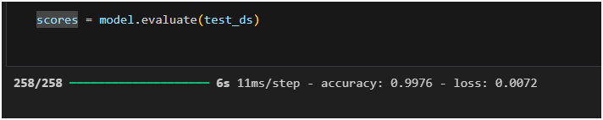
EVALUATION & RESULTS
After training the model, it was evaluated using the test dataset to measure its performance on unseen images.
The evaluation results show that the model achieved a very high accuracy of 99.76% with a low loss value of 0.0072.
These results indicate that the model is able to classify plant leaf images accurately and generalizes well to new data.

Slide 13
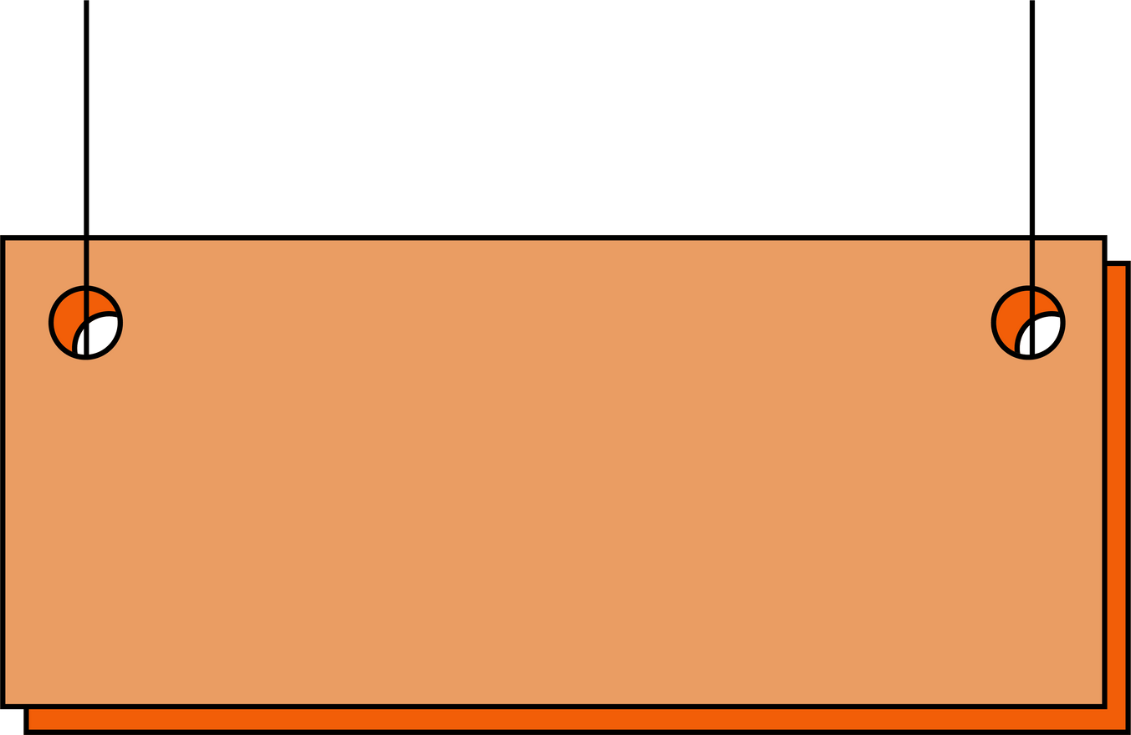
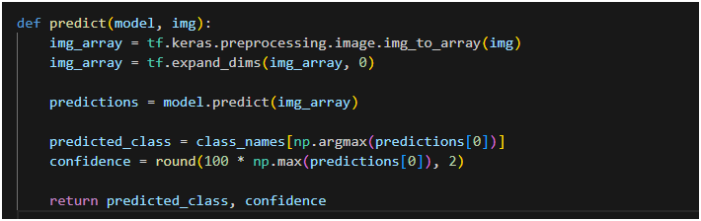
PREDICTION
After the model was trained and evaluated, it was used to predict the class of new images.
The input image is converted into a numerical array and reshaped to match the model’s input format before prediction.
The model processes the image and outputs the predicted class along with a confidence score.
This part shows how the model can identify the disease of a plant leaf based on image data.

Slide 14


After training, the model is saved automatically with a version number.
The code checks existing saved models and assigns a new version to avoid overwriting previous models.
This allows keeping multiple trained versions of the model for later use.
MODEL SAVING

Slide 15


CHALLENGES
the main challenge in this project was using a limited device for training.
This was solved by reducing the image size and batch size, which allowed the model to train successfully
Another challenge was handling many image classes, but after organizing the dataset, the model was able to learn properly.

Slide 16

THANK YOU!

